Slide 1
Introduction to web Development
JEEVIThA S BSC computer science Karan Art and science College Thiruvannamalai

Slide 2

Introduction
Intro
Web development is the process of creating websites or web applications that run on the internet.
Front-End (Client-Side) → What the user sees (design, buttons, text, images). Languages: HTML, CSS, JavaScript
Notes:
Th entation covers the basics of development with a focus on HTML,CSS and JavaScript. Learn how these tecnol

Slide 3
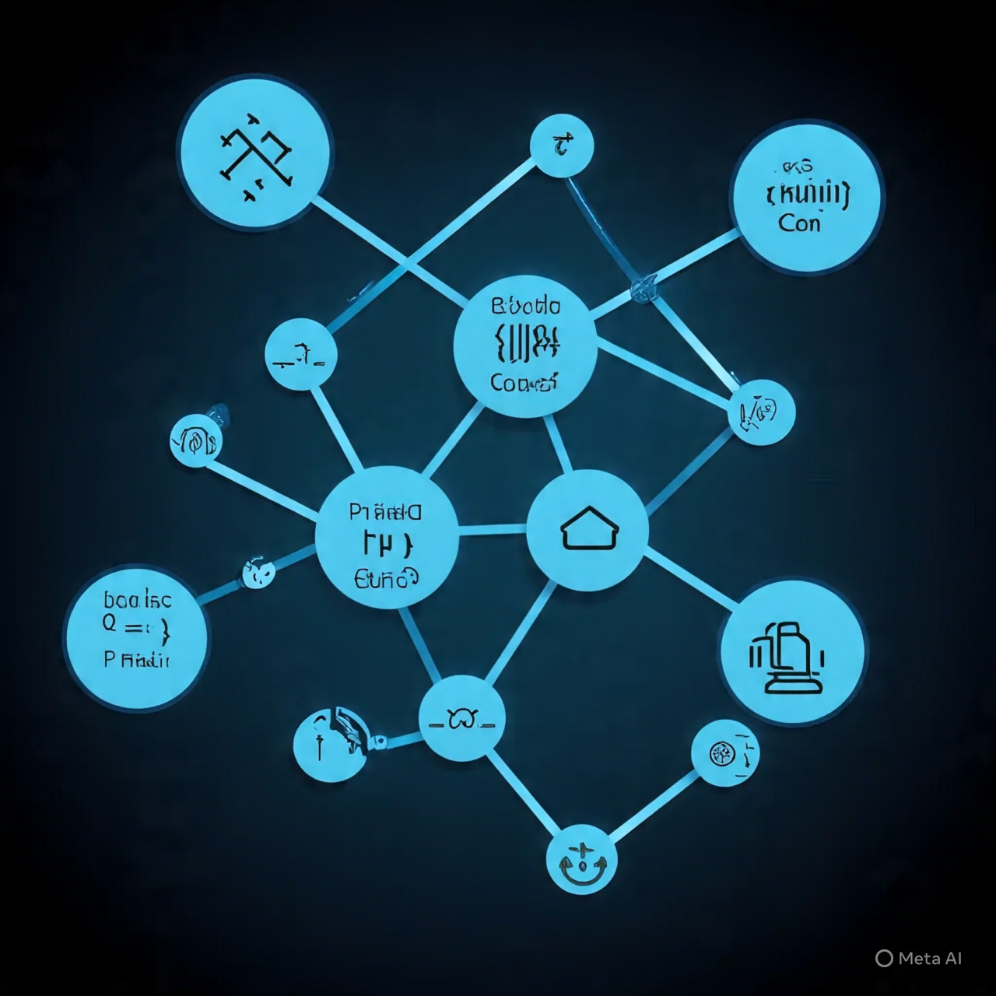
HTML Basics tags, Structure Example
HTML (HyperText Markup Language) is the standard language for creating webpages. It tells the browser what content to display and how it’s structured, but not how it looks (that’s CSS).
Extract the code from it Explain what each part does Fix errors (if any) Give you a clean, working version

Slide 4
Example
This is the foundation of web development. Once you’re comfortable with HTML, CSS, and JavaScript, you can move on to frameworks (like React, Angular, or Django) and databases. 👉 Do you want me to make a step-by-step roadmap for learning web development (from beginner to advanced)?
<!DOCTYPE html><html><head> <title>Page Title</title></head><body> <h1>Hello, World!</h1> <p>This is my first webpage.</p></body></html>

Slide 5
CSS Types, Syntax, Styling Examples

Slide 6
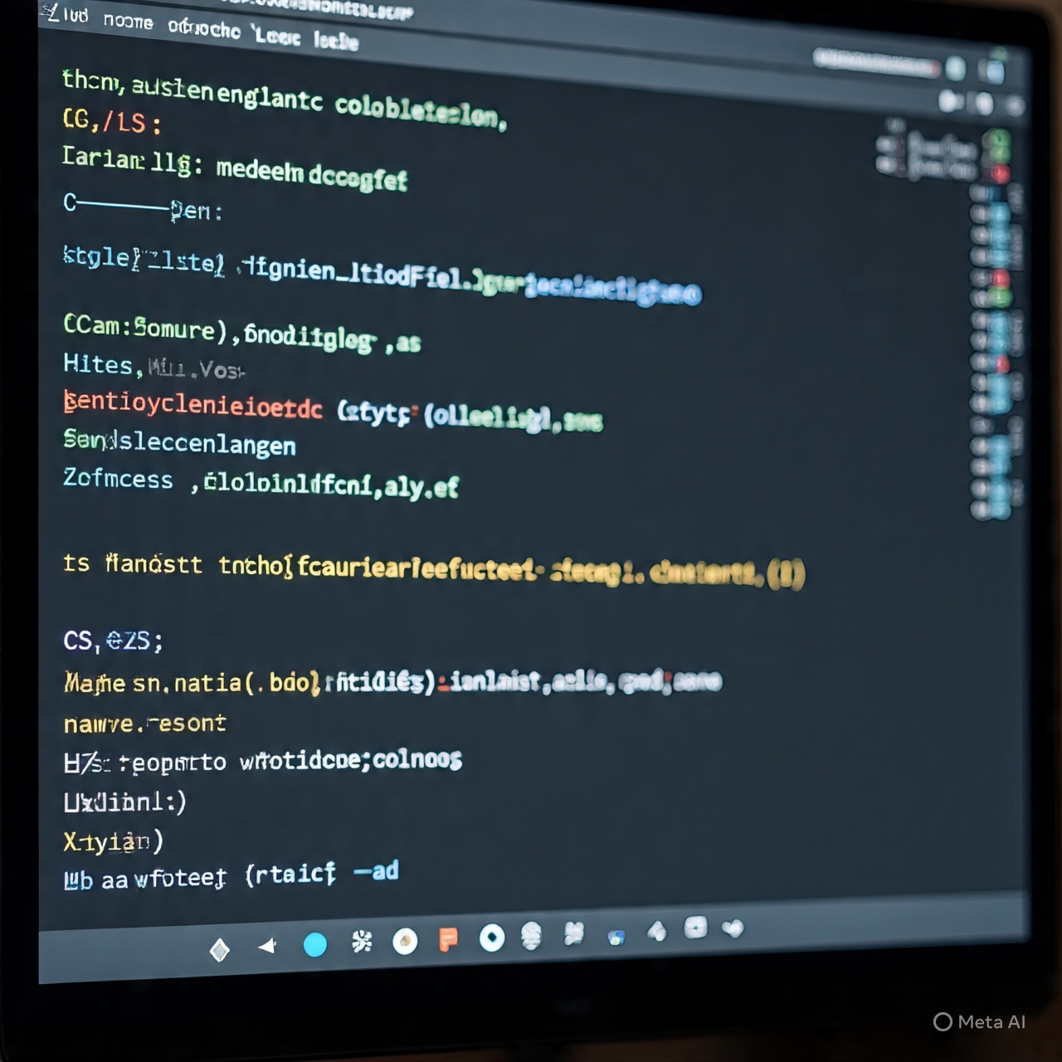
CSS Types
Inline CSS → Written inside an HTML tag using the style attribute.
Internal CSS → Written inside the <style> tag in the <head> section.
External CSS → Written in a separate .css file and linked with <link>.

Slide 7
Syntax
Selector { property: value;
}
P { color: red; font-size: 18px; }

Slide 8
Styling Examples
Text Styling
Background & Colors
Borders & Padding
Buttons Styling
Layout with Flexbox

Slide 9
JavaScript Introduction, features, simple programs, Uses

Slide 10
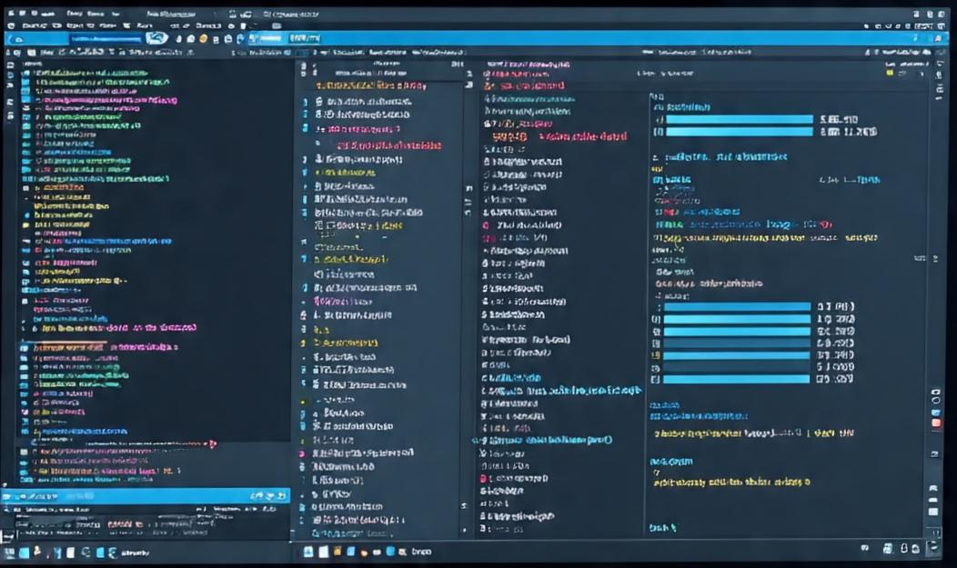
JavaScript Introduction
JavaScript (JS) is a programming language used mainly for making web pages interactive. HTML → Structure CSS → Design JavaScript → Interactivity & Logic It runs directly in the browser (no installation needed).

Slide 11
features
Features of JavaScript 1. Lightweight & Easy to Learn 2. Client-Side Execution → Runs in the browser (fast). 3. Event-Based → Responds to clicks, inputs, keypresses. 4. Versatile → Works for web, mobile apps, games, and even servers (Node.js). 5. Platform Independent → Runs on any OS with a browser.

Slide 12
Simple programs
Print a message <script> document.write(“Hello, World!”); </script>
Variables and Arithmetic <script> let a = 10; let b = 20; let sum = a + b; document.write(“Sum: “ + sum); </script>

Slide 13
Uses of JavaScript
Web Development
Server-Side Development
Mobile Apps
Game Development
Machine Learning & Data Visualization

Slide 14
Real-time Application/Important in Web Development
Importance of Web Development Web development is everywhere — every website, app, and online tool you use is built with it. It allows businesses, organizations, and individuals to: Share information (Wikipedia, Blogs) Sell products & services (Amazon, Flipkart) Provide communication (WhatsApp Web, Gmail) Offer entertainment (YouTube, Netflix)

Slide 15
Reference
1. W3Schools – Web Development Tutorials 2. MDN Web Docs – HTML, CSS, JavaScript 3. GeeksforGeeks – Web Development Basics 4. freeCodeCamp – Learn Web Development

Slide 16
Conclusion
Conclusion Web development is the backbone of the modern internet. HTML provides the structure of web pages. CSS makes them attractive and responsive with styling. JavaScript adds interactivity and logic, making web pages dynamic.

Slide 17
🔸Thank You…

